Slide 1
Fixing Funky Foods
Presented By:
Written By: Robin Eubank-Callis, M.S.
K-State Research & Extension Barber County
Family and Consumer Science Agent
Notes:
This program was inspired by an ever increasing variety of foods available in Rural Kansas grocery stores.
It is designed to share the nutritional value of many food items and potential uses.
Introduction Question: Ask participants what they have seen things in their grocery stores, but didn’t know how to prepare. (We may not cover all answers in this program.)

Slide 2

Notes:
Experience new foods
New ways to try foods
Learn health benefits of foods

Slide 3
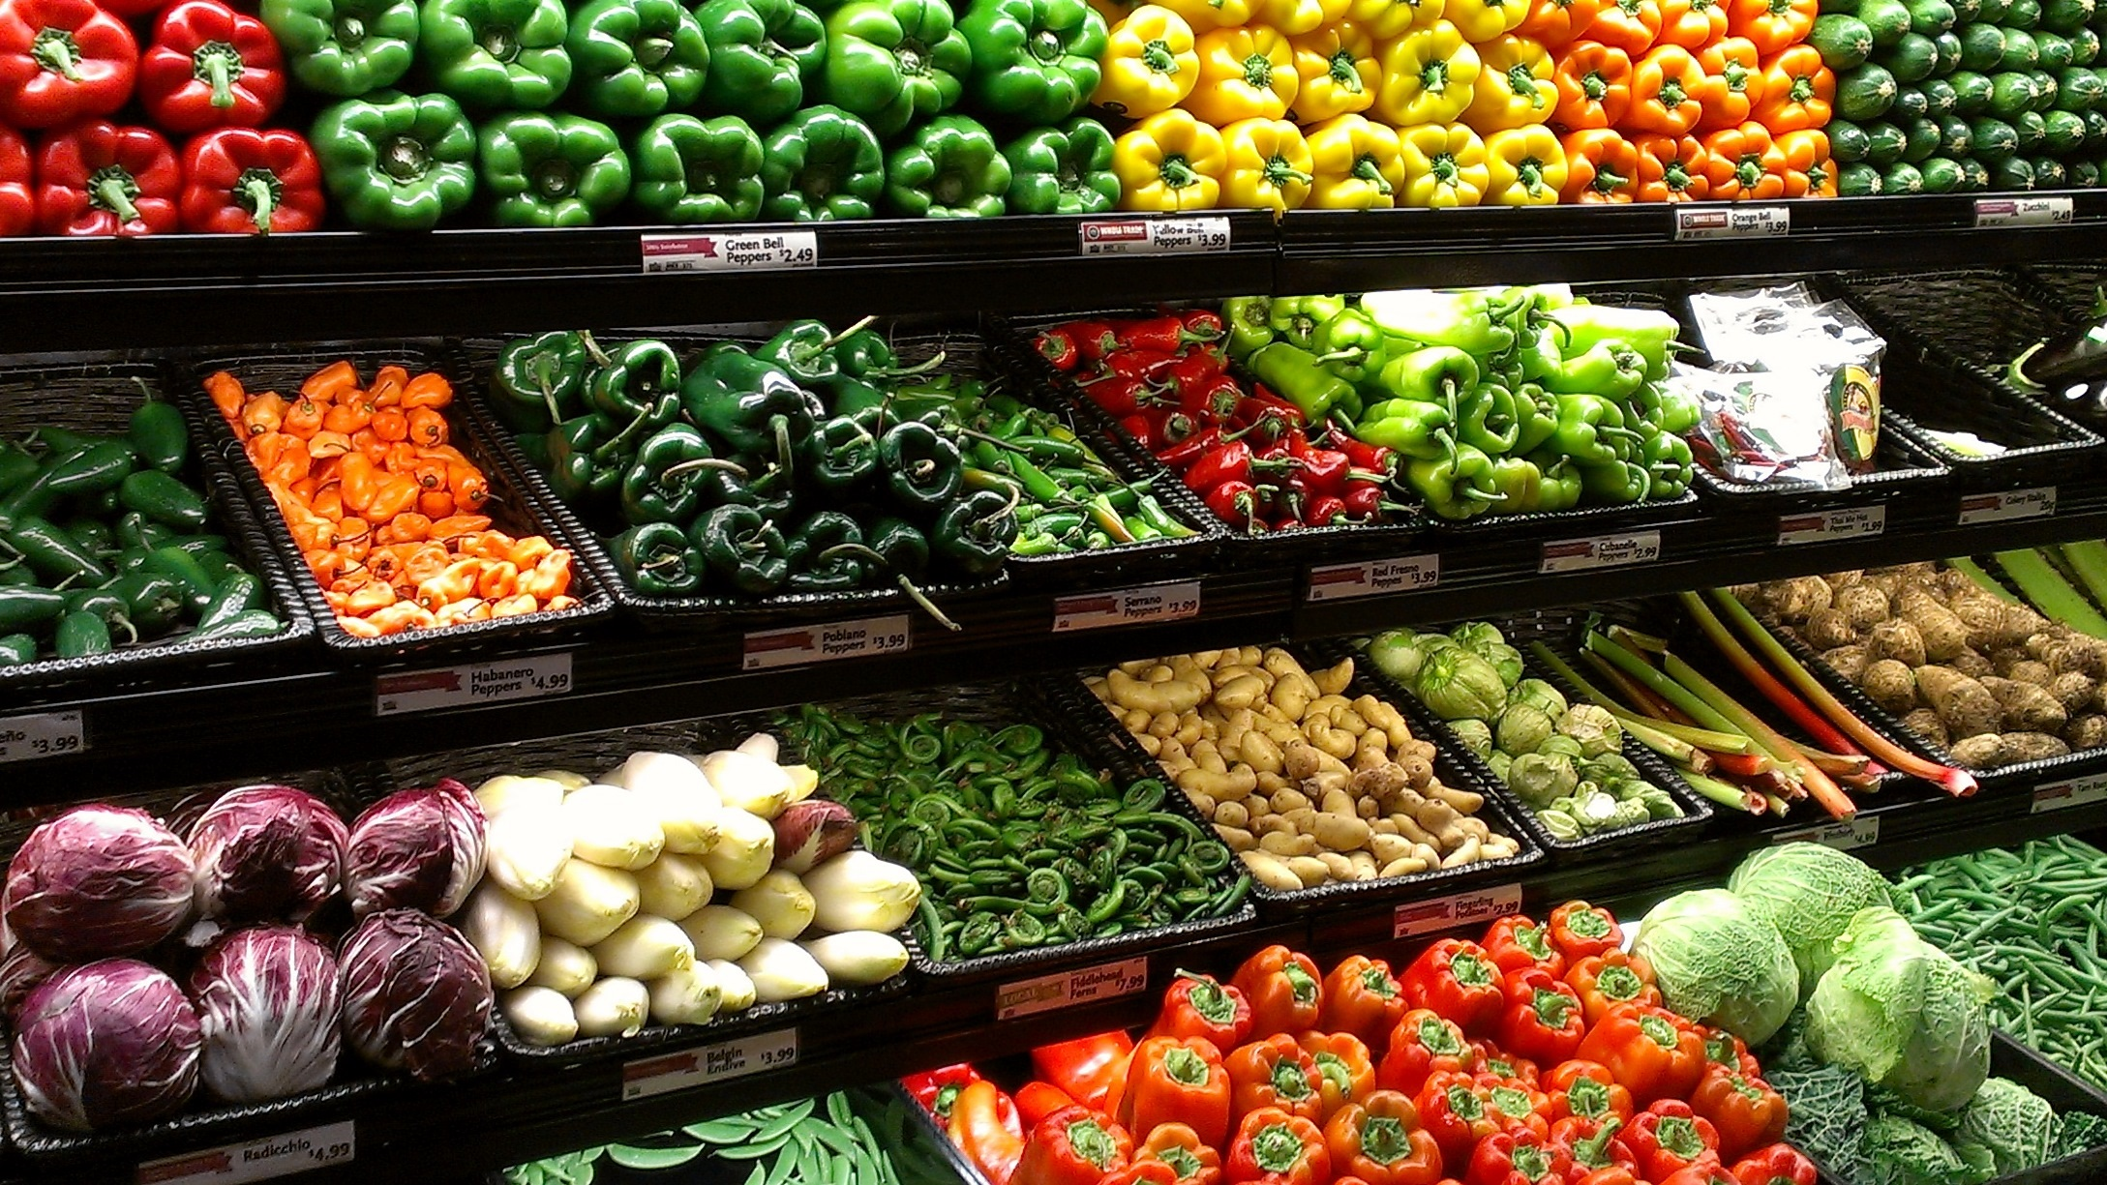
Background
Notes:
20,000 new foods are introduced each year*
25% are Candy, Gum or Snacks*
20% are Beverages*
The focus of this program is on foods that have existed for years, but are new to being readily available in rural communities.
Discussion Question: Ask what they see in this photo that may not be in their local store.
* Source: USDA Economic Research Service

Slide 4

Dietary Guidelines
Notes:
75% of US population has eating pattern low in fruit, vegetables, dairy and healthy oils.
More then 50% meeting or exceeding total grain and protein food intake
Key Recommendations suggest a healthy eating pattern that includes
Variety of Vegetables – Including all subgroups
Whole Fruits
Whole Grains
Low-Fat Dairy
Variety of Protein

Slide 5
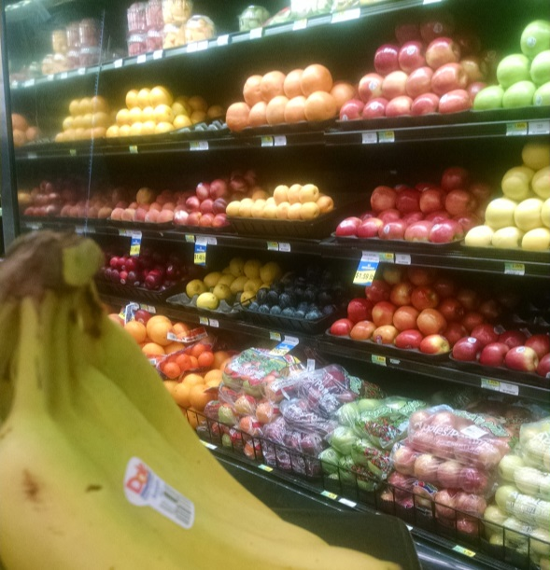
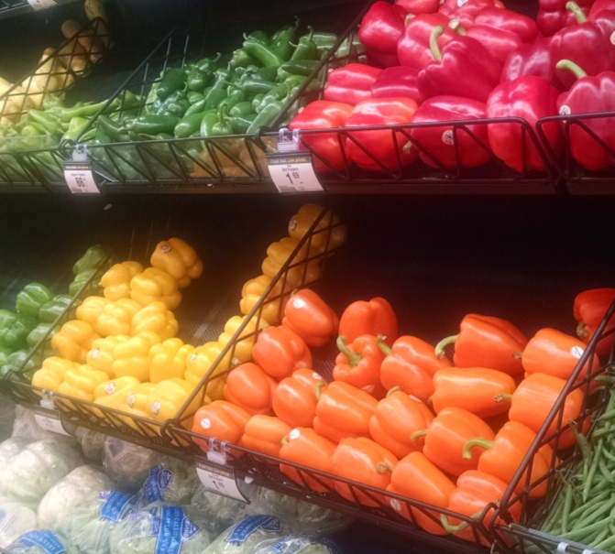
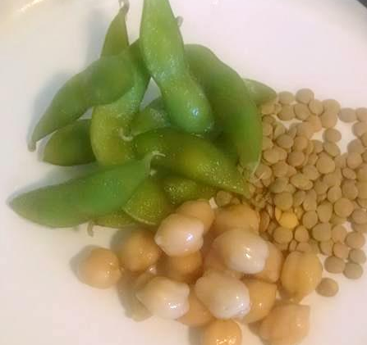
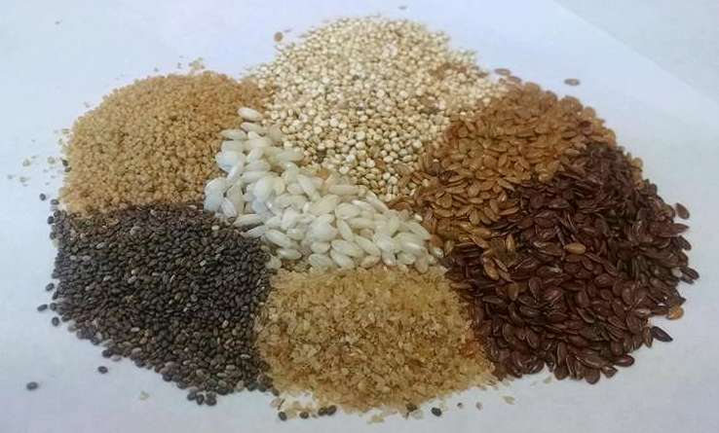
Foods
Notes:
This slide allows you to jump to any of the 4 sections
Fruit
Vegetables
Grains
Proteins
The FFF in the bottom right corner will bring you back to this page during the Slide Show View
The K-State Logo will jump you to the Questions Slide to use at the end of the program.

Slide 6


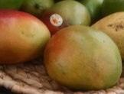
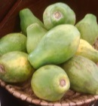

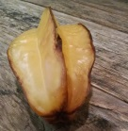
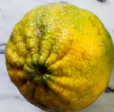
Fruit
Notes:
The small images allow you to skip to the fruits you want to include. (The hyperlinks work only in Slide Show View.)
Blood Orange
Mango
Papaya
Persimmons
Star Fruit
Ugli Fruit

Slide 7
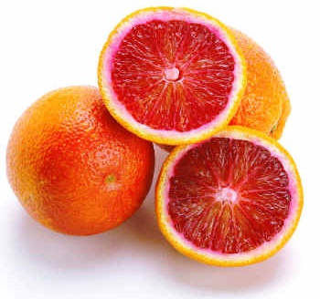
Blood Orange
Notes:
High in vitamin C, fiber, folic acid
Store at room temperature
Red flesh develops during low temperature nights.
Uses: salad and marmalade

Slide 8
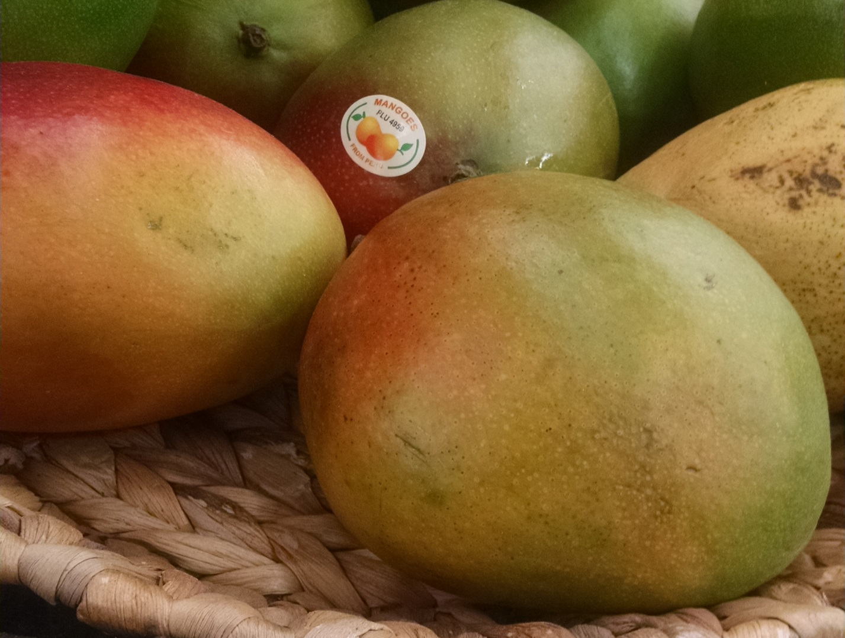
Mango
Notes:
High in vitamin A and C
Store at room temperature
Cut flesh off of pit
Smaller ones are best
Uses: salad, salsa, smoothie, sorbets

Slide 9

Papaya
Notes:
High in vitamin A, C, fiber and potassium
Store at room temperature
When ripe, the skin yields to slight pressure
Uses: salad, salsa, meat tenderizer in marinades

Slide 10
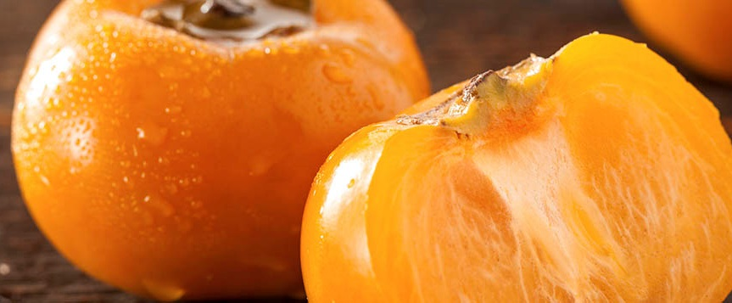
Persimmons
Notes:
High in vitamin C
Refrigerate
Soft, deep red-orange skim when ripe
Hard fruit is tart
Uses: fruit salad, green salad, cooked quickly under broiler

Slide 11

Star Fruit
Notes:
High in vitamin C
Slow to discolor
Avoid brown spots
Skin is edible
Uses: Garnish, salad

Slide 12
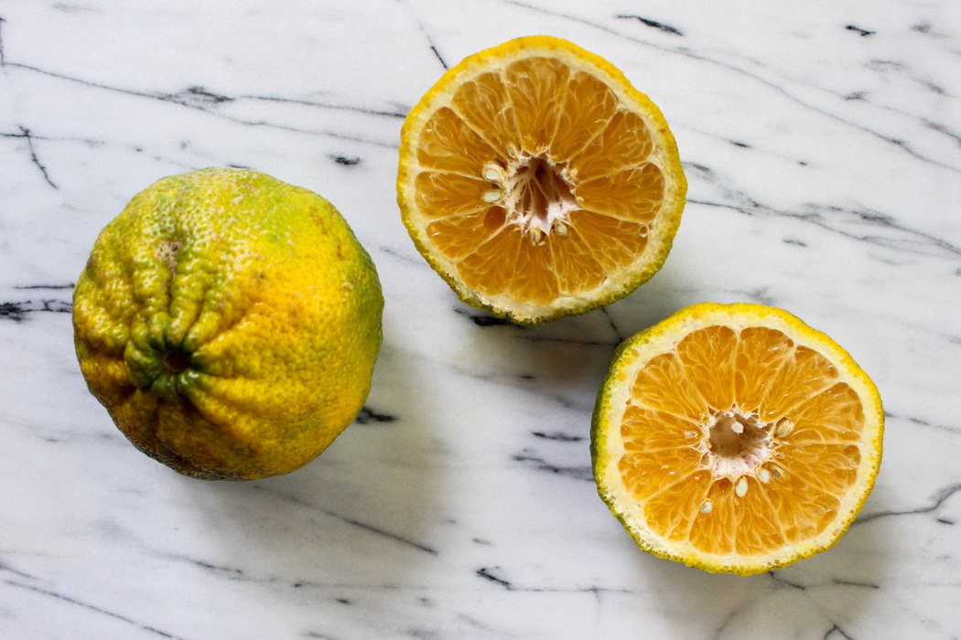
Ugli Fruit
Notes:
High in vitamin C, fiber, folic acid
Similar to grapefruit, only sweeter
Citrus fruit created by hybridizing a grapefruit, an orange, and a tangerine
Uses: salads and eating fresh

Slide 13
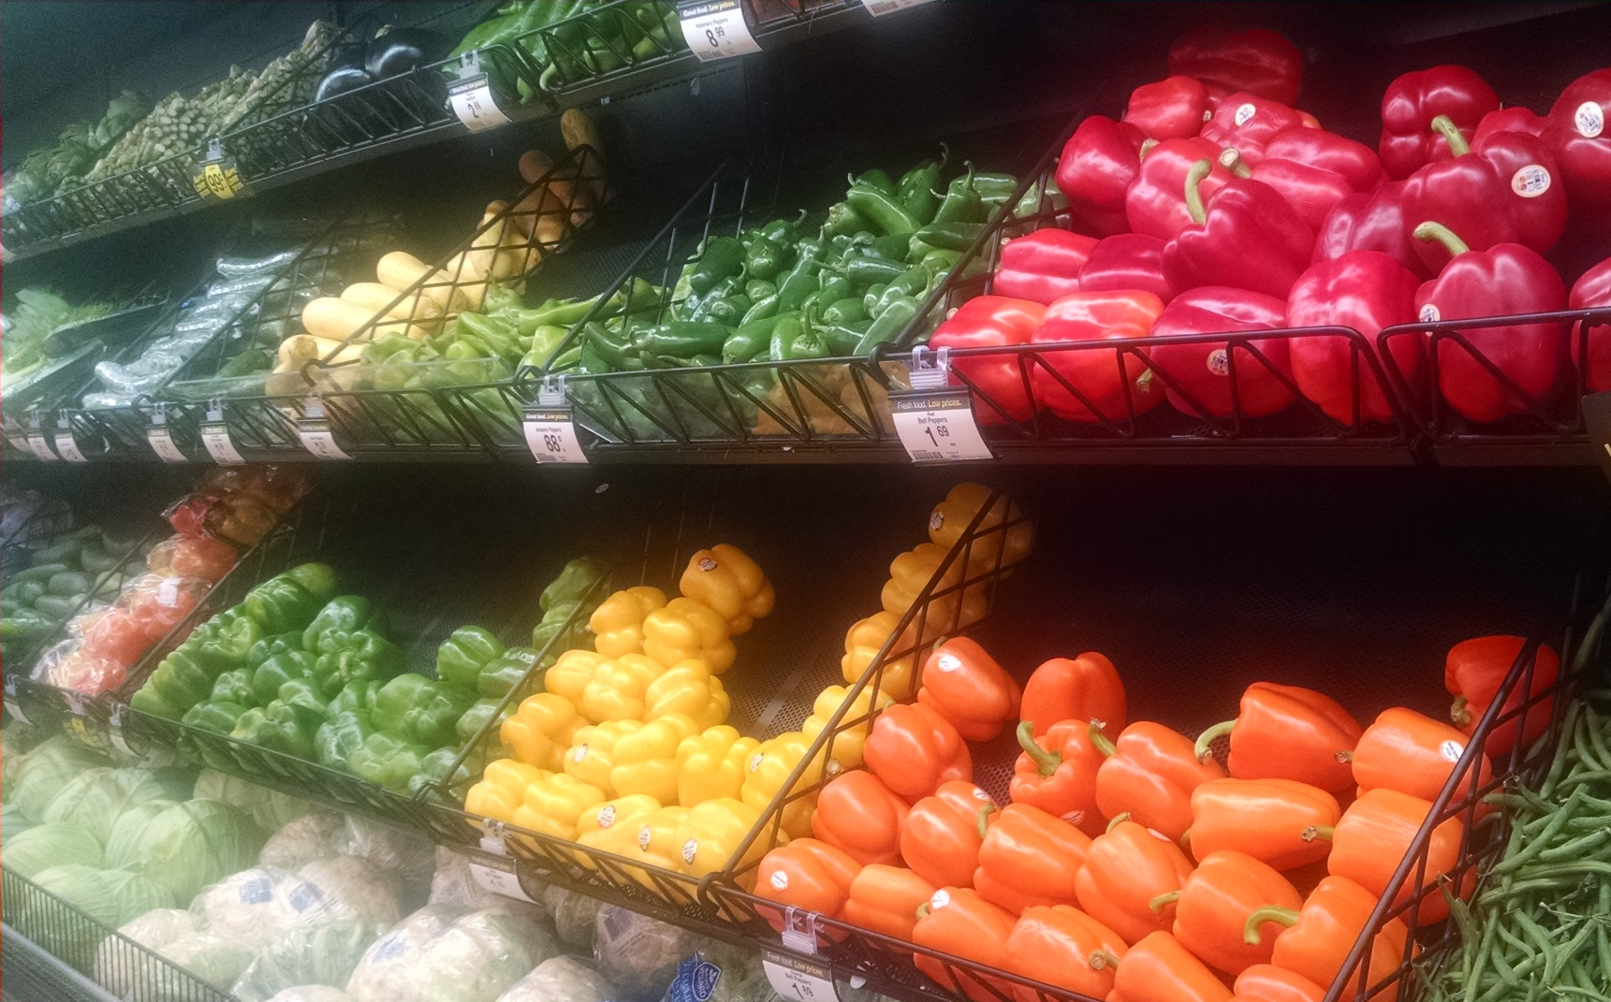
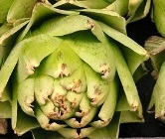
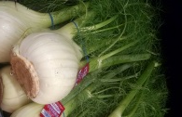
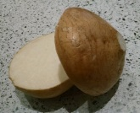
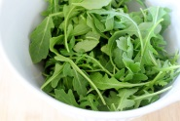
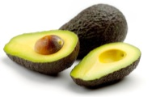
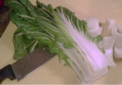
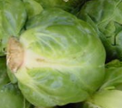
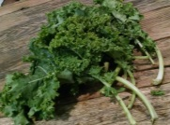
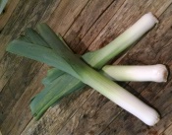
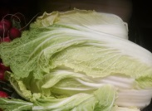
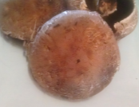
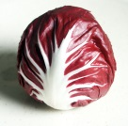
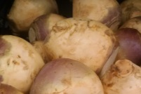
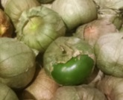
Vegetables
Notes:
The small images allow you to skip to the vegetables you want to include. (The hyperlinks work only in Slide Show View.)
Artichoke
Arugula
Avocado
Bok Choy
Brussel Sprouts
Fennel Bulb
Jicama
Kale
Leeks
Napa Cabbage
Portobello Mushroom
Radicchio
Rutabaga
Tomatillo

Slide 14
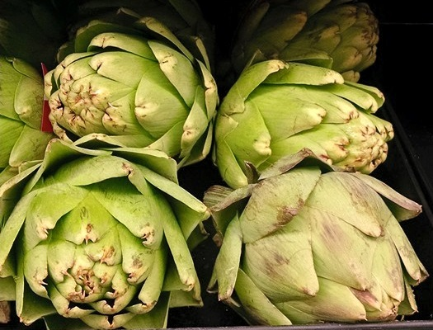
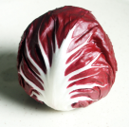
Artichoke
Notes:
High in fiber, sodium, and vitamin C
Flower bud of plant
Both Greeks and Romans ate with honey and vinegar
Uses: boil, steam, sauté, microwave

Slide 15

Arugula
Notes:
Good source of vitamin A, C, K, iron, and calcium
Peppery taste
Mediterranean origin
Add to salads & sandwiches
Pasta with goat cheese

Slide 16
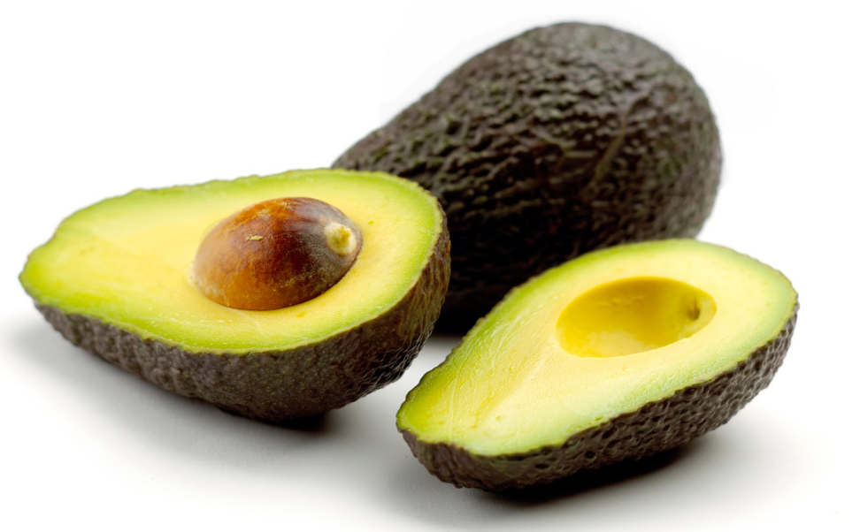
Avocado
Notes:
High in vitamin B, C, E, potassium, magnesium, folate and fiber
Dark skin shows ripeness
Uses: add to sandwiches, salads, or in place of sour cream

Slide 17
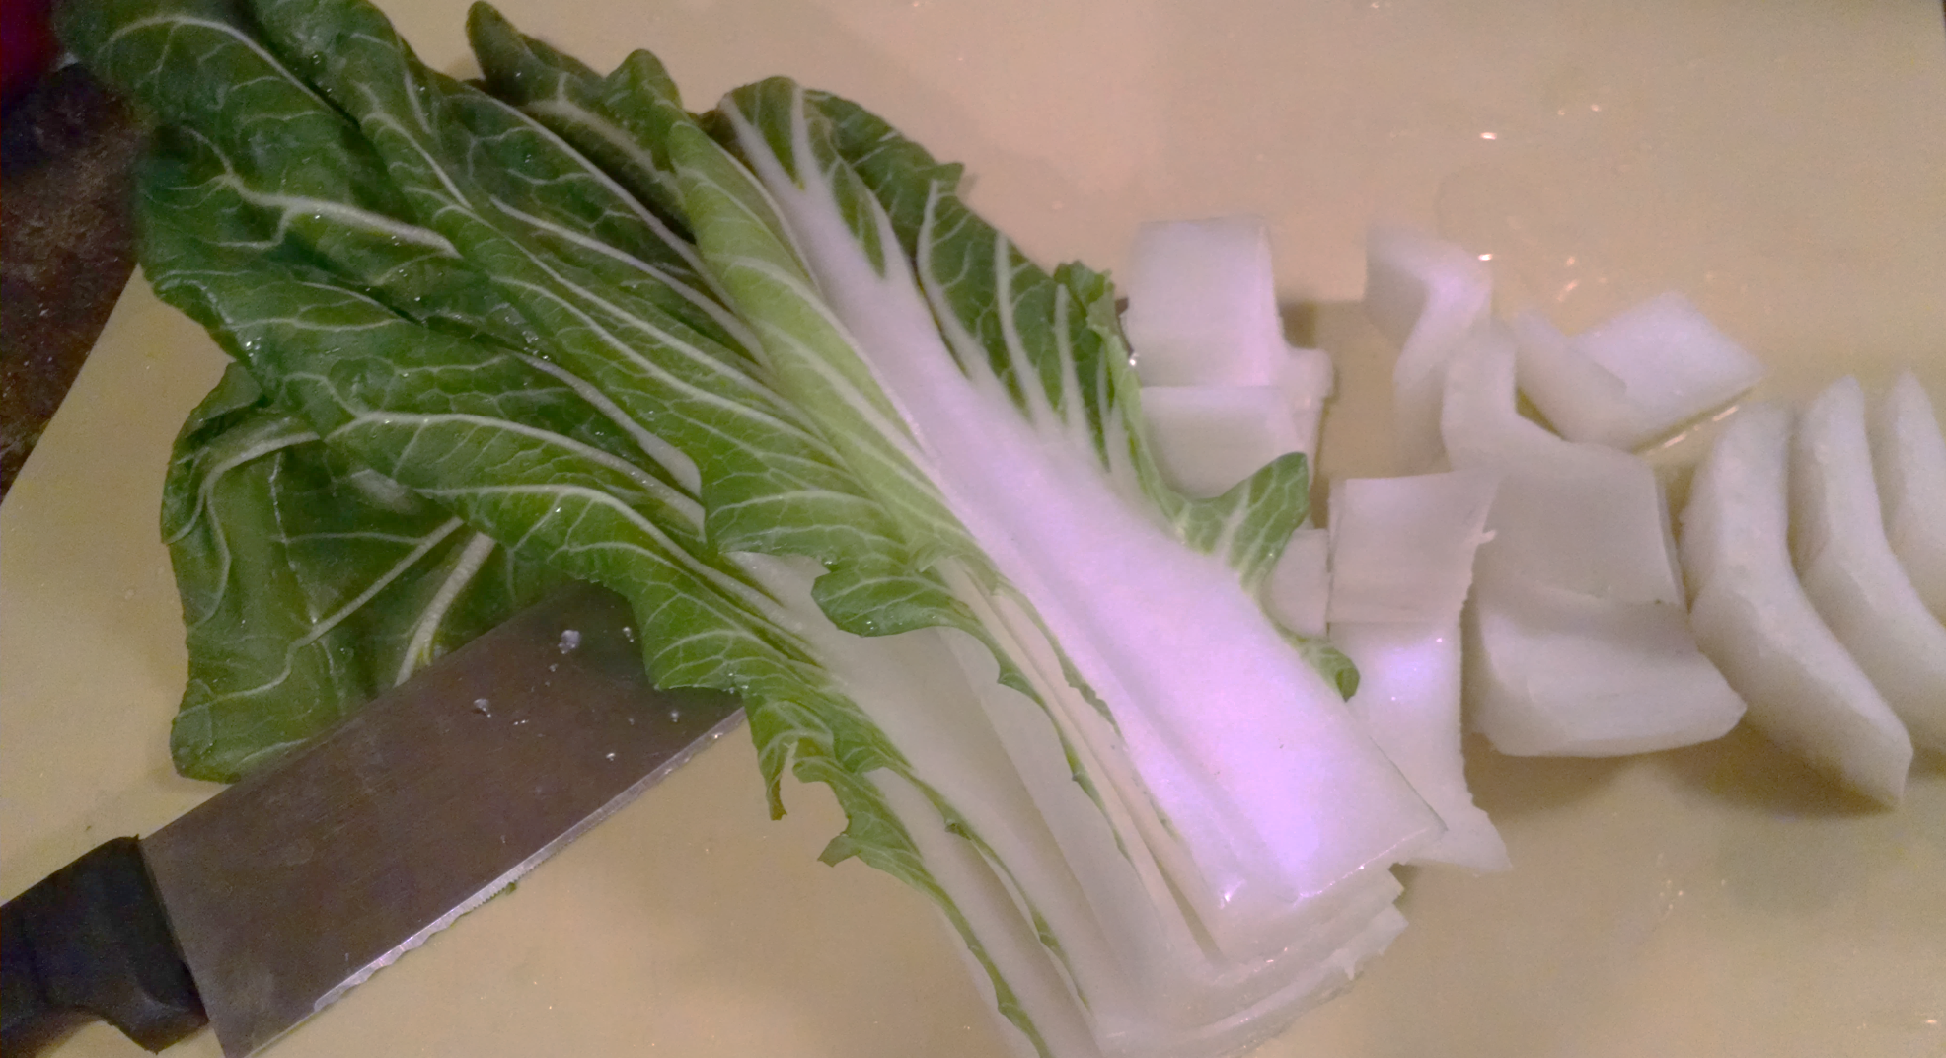
Bok Choy
Notes:
High in vitamin C, A, K, and B complex
Popular in China and Philippines
Best in winter season
Slice stalks in half and cut 1 inch or smaller pieces
Uses: Salads, mixed with cabbage in slaw, stir-fries

Slide 18
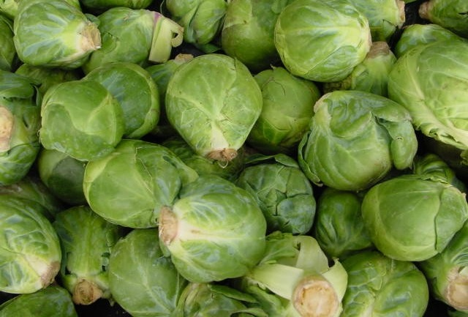
Brussel Sprouts
Notes:
High in vitamins A, C, K, folic acid, manganese, phosphorus
French settler brought to Louisiana in 18th century
Before cooking, cut an x on the stem end
Uses: sauté, stir-fry, steam or microwave. (Being added to chopped bagged salads in stores.)

Slide 19
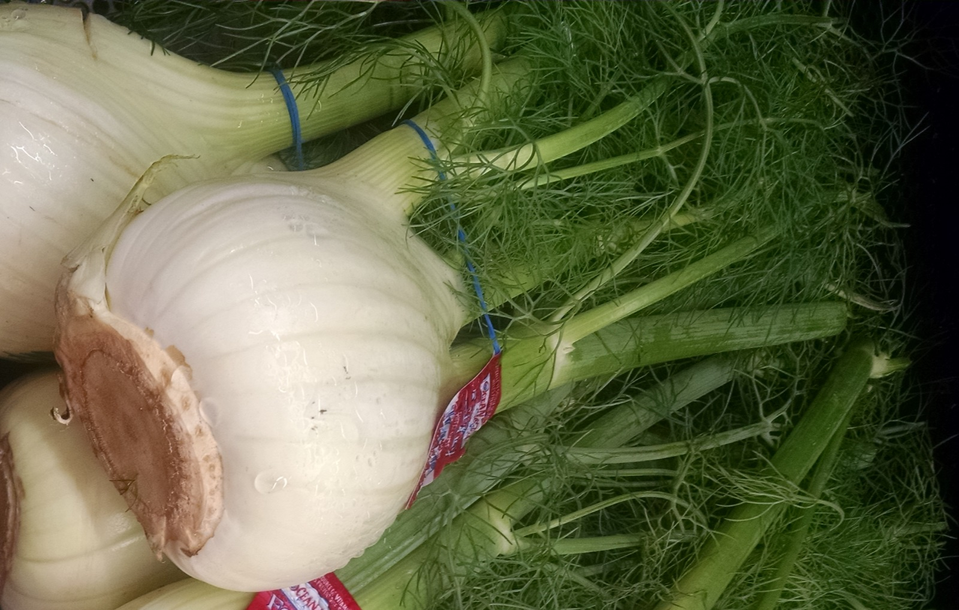
Fennel Bulb
Notes:
High in vitamin C, fiber, potassium
Discard feathery tops
Flavor similar to anise or licorice, becomes milder when cooked
Uses: braised, grilled, roasted, or steamed

Slide 20
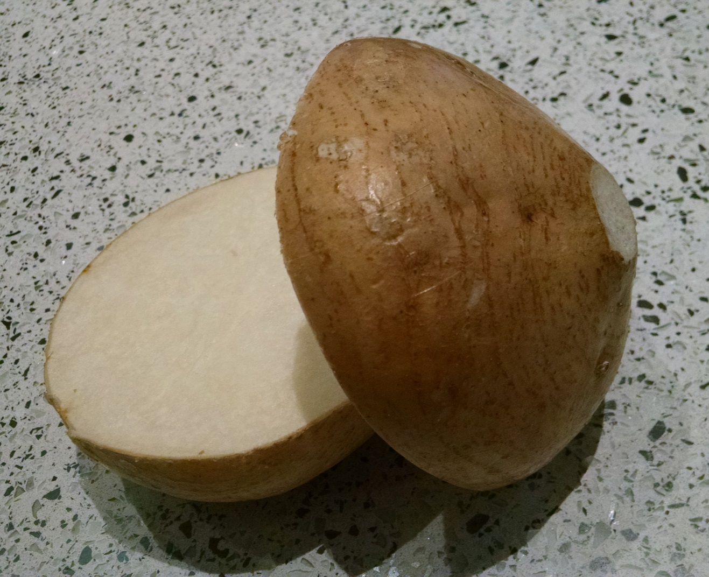
Jicama
Notes:
Good source of fiber, vitamin C
Root vegetable – like turnips
Sweet pear/apple taste
Grown in Central America & Caribbean
Peel, eat fresh with lime juice, salt, chili powder or paprika
Uses: salads, slaw, stews, stir-fries

Slide 21

Kale
Notes:
High in vitamin A, C, & K, iron & potassium
Best during winter months
Native to Mediterranean
Uses: Raw in salads, sautéed, soups, stews, and pasta

Slide 22

Leek
Notes:
High in vitamin B, C, and folic acid
Only the white part is eaten
Primary used to flavor soup or stock
Slice stalks in half, rinse to remove sand
Uses: boil, sauté, stir-fry.

Slide 23
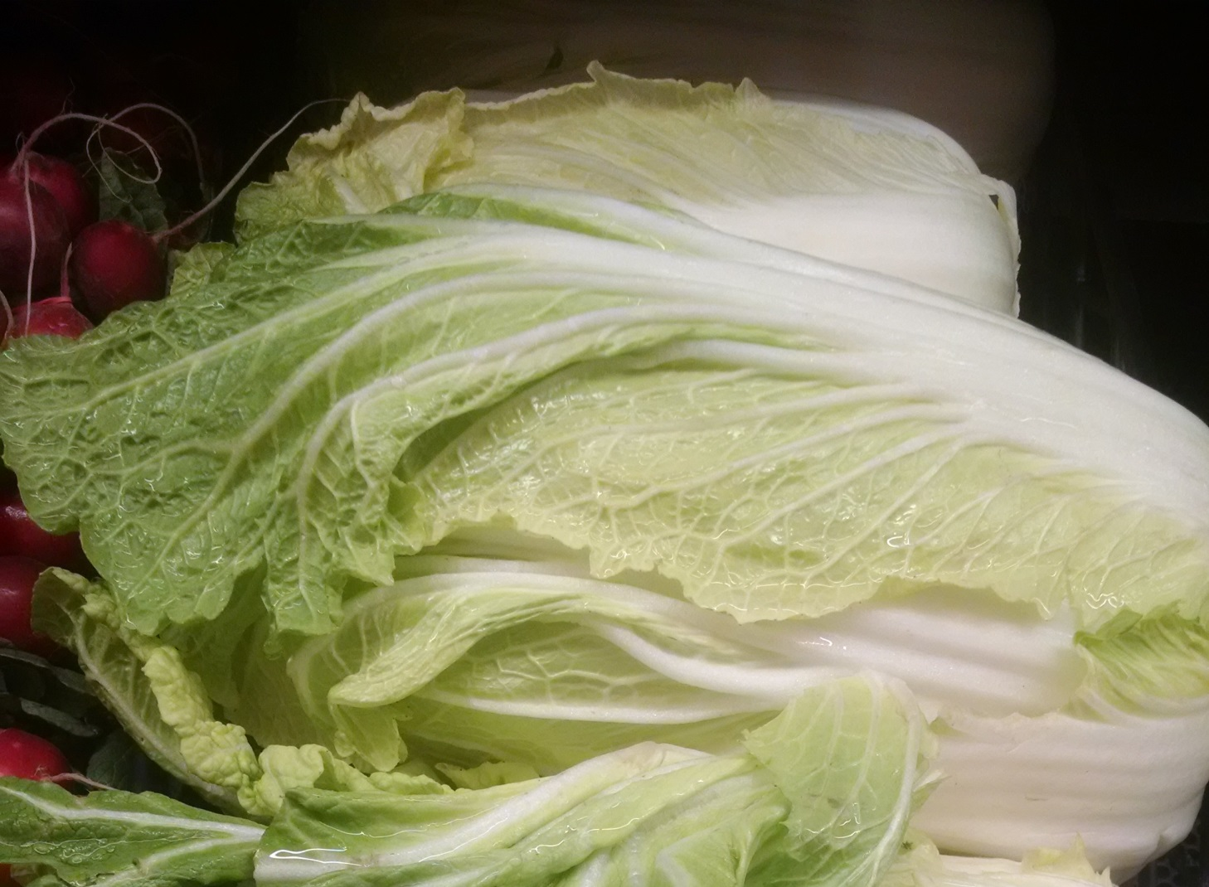
Napa Cabbage
Notes:
High in vitamin C
Common ingredient in Asian stir fry
Made into kimchi
Milder, more delicate than cabbage
Uses: stir fry, sauté, slaw, salad

Slide 24
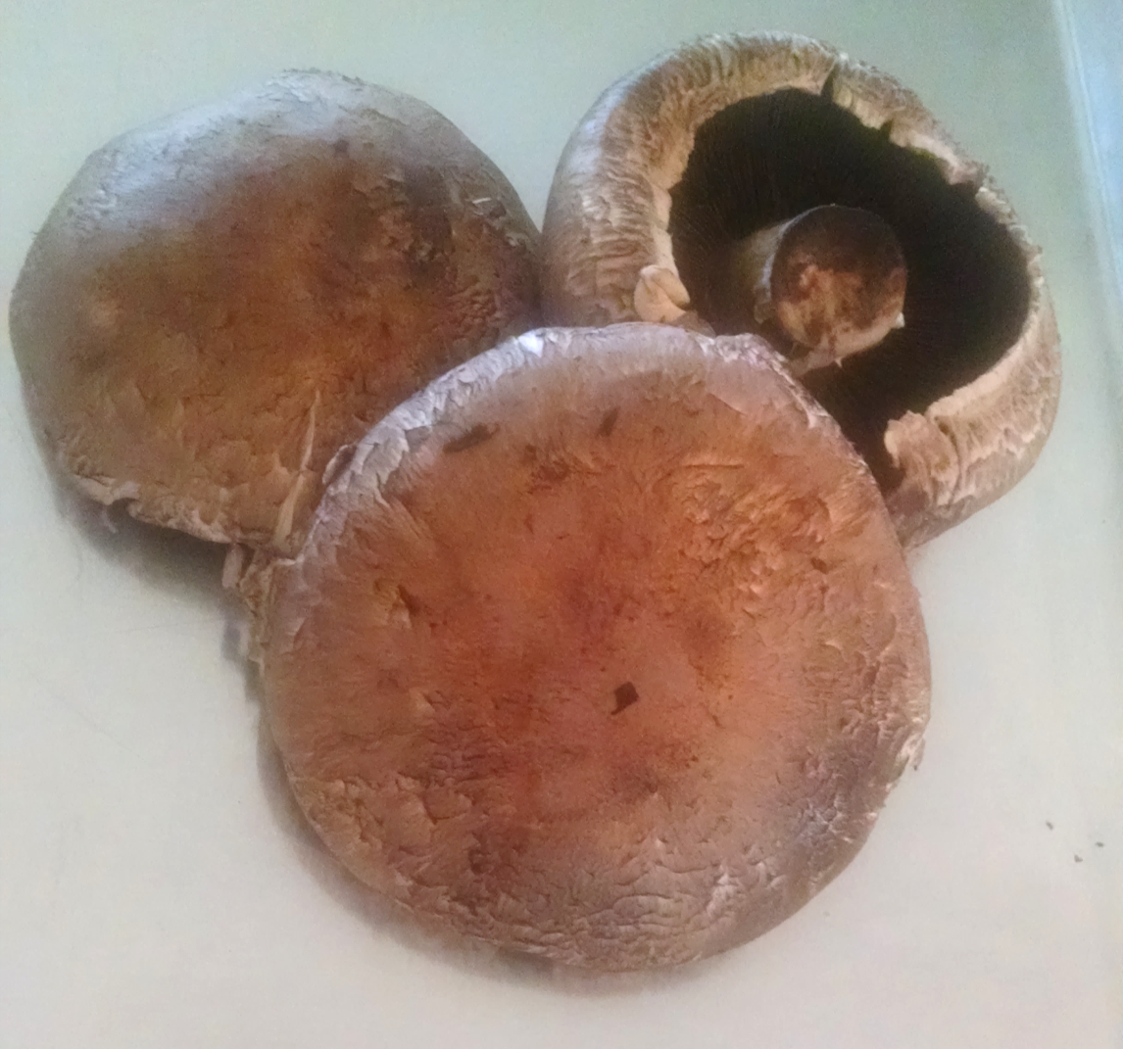
Portobello Mushroom
Notes:
High in vitamin B, selenium, potassium, and phosphorus
Large cremini, larger are more flavorful
Wipe to clean, do not soak
Uses: grilling, roasting, sauté, hamburger substitute

Slide 25

Radicchio
Notes:
Folic acid, vitamin B, K, and copper
Bitter, peppery flavor
Used in Italy for centuries
Cook similar to cabbage
Uses: Leafy salad vegetable

Slide 26
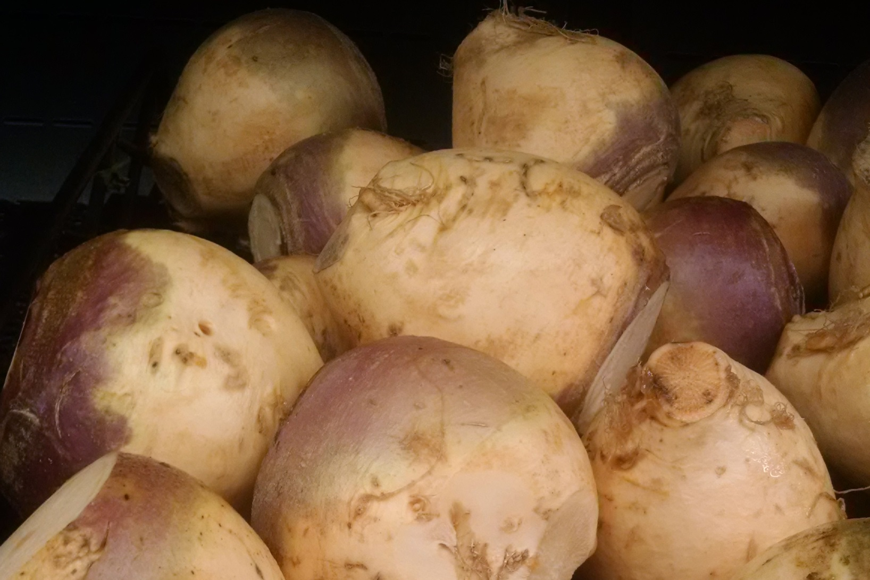
Rutabaga
Notes:
High in vitamin A & C
Store in cool, dry place for a month or longer
Uses: boil and serve mashed, roasted, soup or salad
Different from turnips
Turnip: smaller, smoother, usually white flesh, greens are used raw or cooked, harvested in summer
Rutabaga: cross between a cabbage and a turnip, larger with a rough exterior, usually yellow flesh, greens not generally eaten raw, harvested in fall

Slide 27
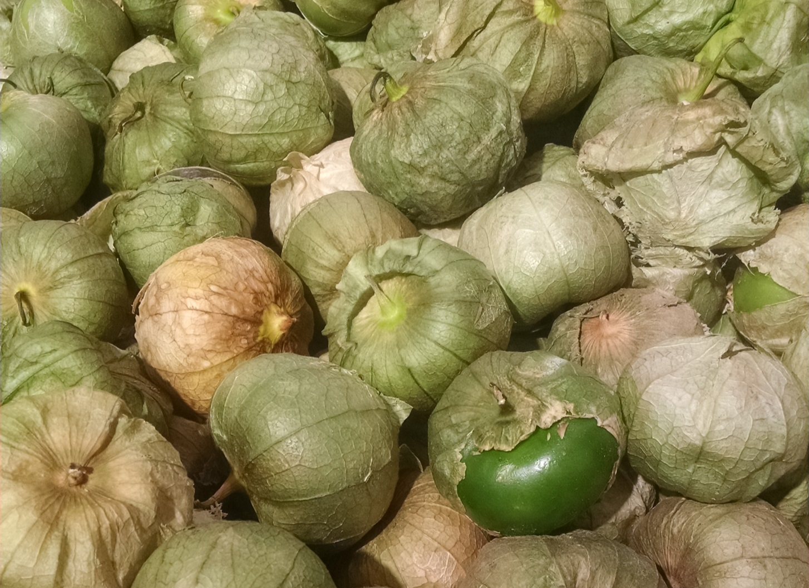
Tomatillo
Notes:
High in vitamin C
Husk should be light brown and fresh looking
Should be firm
Common in Texas gardens, can be grown in Kansas
Needs to be washed after husks removed
Common use: remove husks, cook whole or in pieces, steam in small amount of water for 5-7 minutes, and add salt, pepper & chilies to make relish

Slide 28
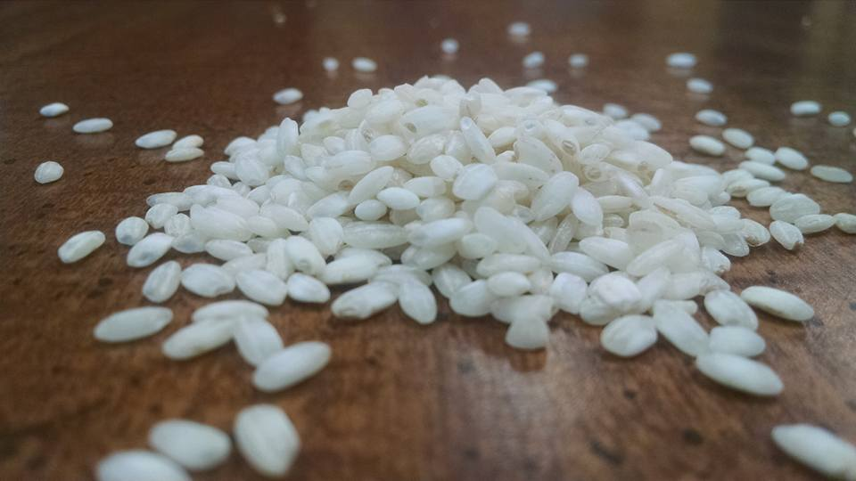
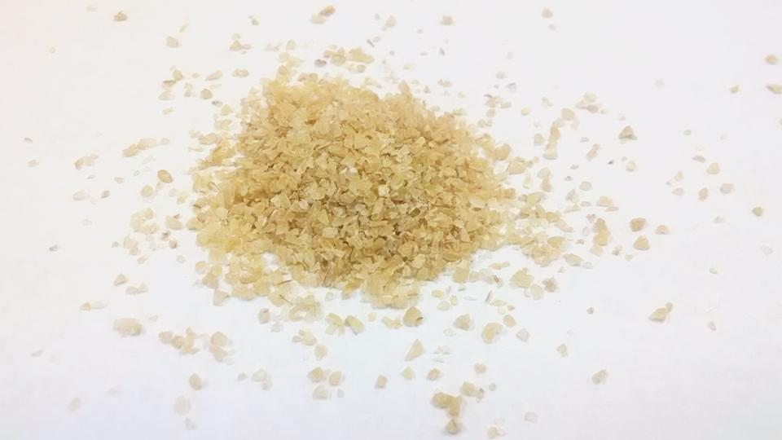
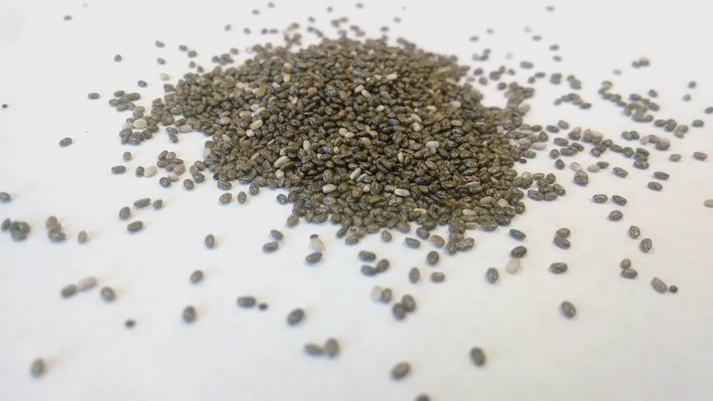
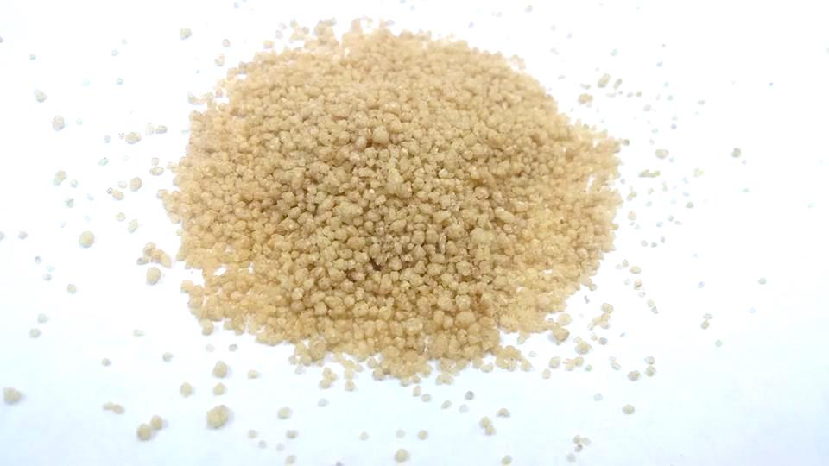
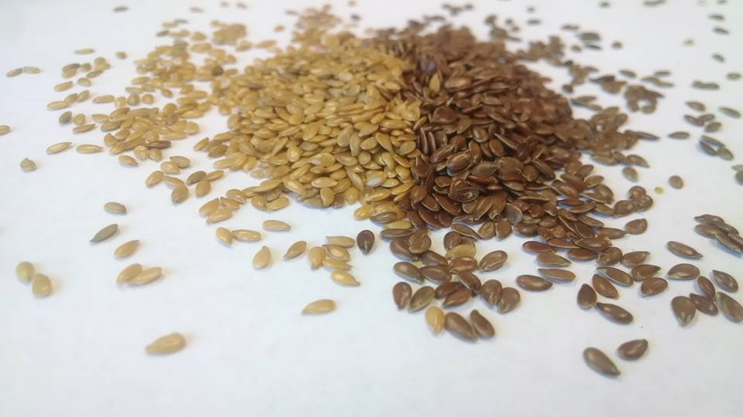
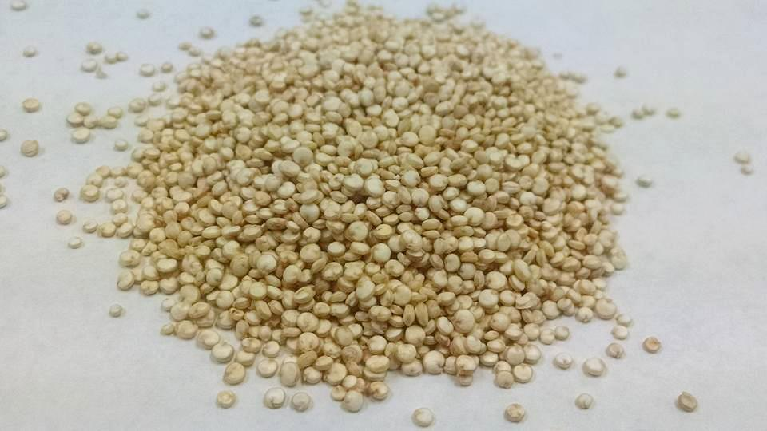
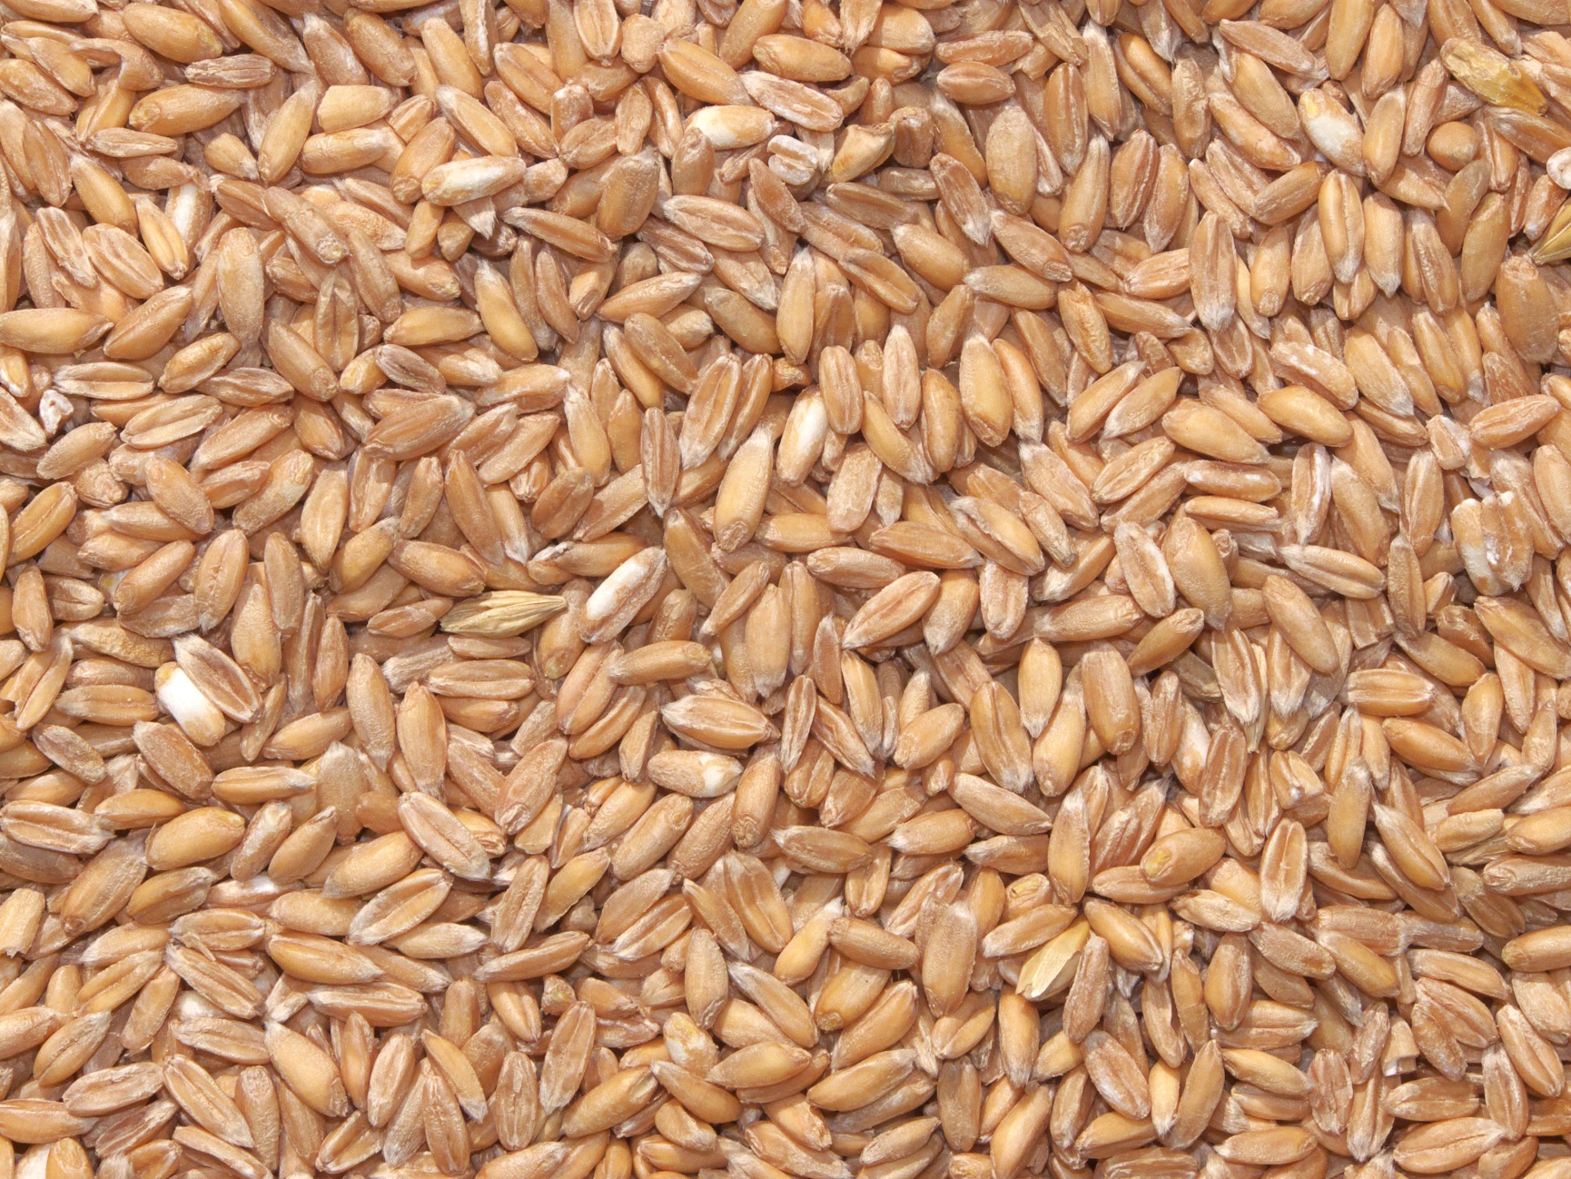
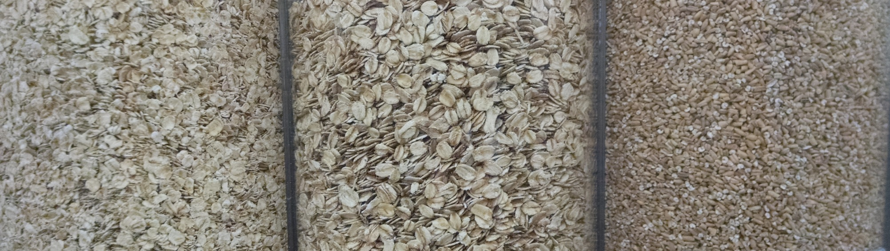
Grains
Notes:
The small images allow you to skip to the grains you want to include. (The hyperlinks work only in Slide Show View.)
Arborio Rice
Bulgur Wheat
Chia Seeds
Couscous
Flax
Quinoa
Spelt
Steel Cut Oats

Slide 29
Arborio Rice
Notes:
Nutritionally like white rice
Higher in starch = creamier texture
Grown in Italy
Most common in risotto
Uses: salads or rice pudding

Slide 30
Bulgur Wheat
Notes:
High in vitamin B, fiber, protein, and magnesium
Wheat that is soaked, boiled, dried, then cracked removing some bran
Dates to 2,800 B.C.
Sold as Pilaf or Taboli (many spellings)
Uses: meatloaf, soups, stews, casseroles, or salad

Slide 31
Chia Seeds
Notes:
Very high in fiber
Mild nutty flavor
Staple in Mayans & Aztecs diets
Chia derived from Mayan language meaning strength
Uses: chia gel can be substituted for eggs in baked dishes or eat fresh

Slide 32
Couscous
Notes:
High in trace mineral - selenium
Made from whole wheat flour
Traditional in North Africa
Cooks quickly in hot water, fluff with a fork.
Uses: Substitution for rice

Slide 33
Flax
Notes:
High in omega-3 fatty acids, and fiber
Milled=ground=flax meal
Grind your own in a blender or food processor
Dates to Babylon in 3000 B.C.
300 flax products released in 2010
Uses: Add a tablespoon of ground to oatmeal, soup or yogurt
Substitute for 1/8 to 1/4 of flour in baked goods.

Slide 34
Quinoa
Notes:
High in vitamins B, E, fiber, calcium, iron, and phosphorus
Good plant protein
High in originated in South America 3000 years ago.
Gluten free grain
Uses: pasta substitute, salads, and hot side dish

Slide 35
Spelt
Notes:
High in vitamin B, fiber, protein, manganese, magnesium, and phosphorus
Also called dinkel wheat or hulled wheat
Dates to 5000 B.C.
Contains gluten
For soft: Use 3 cups of water to 1 cup spelt and simmer for 90 minutes
For chewier: Use 2 cups of water added ½ cup at a time.
Uses: often used as flour and mixed with other grains

Slide 36
Steel Cut Oats
Quick Cooking Rolled Steel Cut
Notes:
High in fiber, iron and protein
Nutritionally similar to rolled oats
Nuttier flavor
Called Irish or Scottish Oats
Quick cooking steel oats may be available
Takes longer cooking time (35 minutes for oatmeal)
Can soak overnight to reduce time to 5 minutes
Uses: oatmeal or cooking

Slide 37
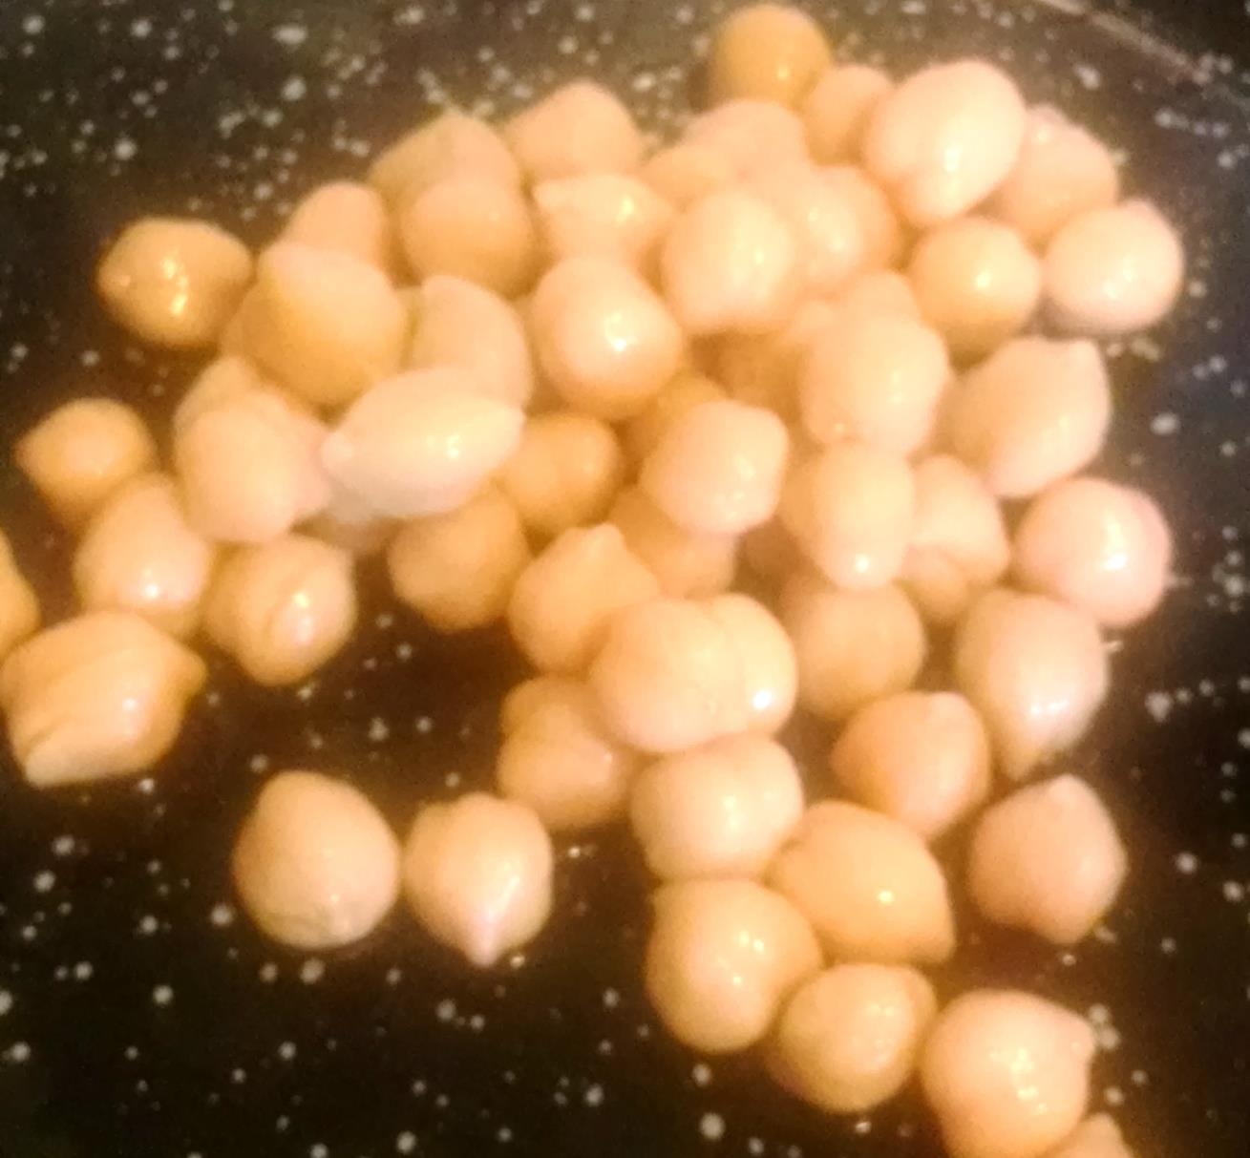
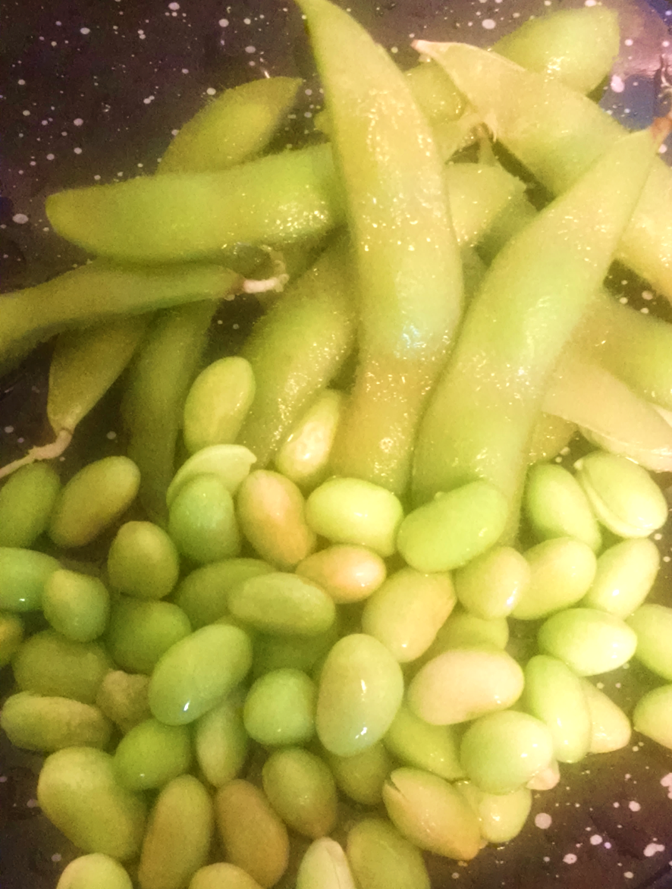
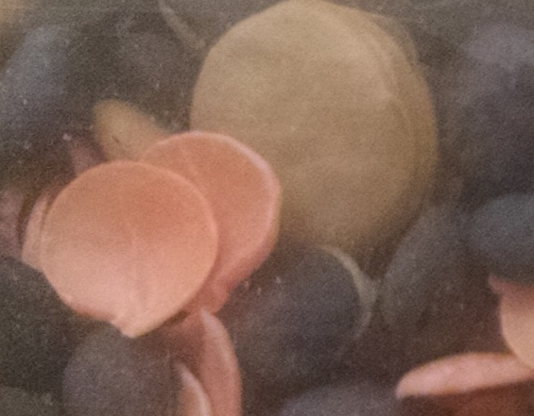
Protein
Notes:
The small images allow you to skip to the proteins you want to include. (The hyperlinks work only in Slide Show View.)
Chickpeas
Edamame
Lentils

Slide 38
Chickpeas
Notes:
Also known as garbanzo beans
High in iron, vitamin C, protein & fiber
Popular in Middle East, North Africa
Uses: hummus, stews, salads, and snacks
Hummus is cooked and mashed chickpeas with tahini, olive oil, lemon juice, salt and garlic.
Often served with pita bread

Slide 39
Edamame
Notes:
Also known as young soybeans
High in vitamin B, C, fiber, iron, magnesium and potassium
Often a frozen food, comes shelled or in pods
Originated in Japan around 1275
Uses: salads, Asian foods, and snacks

Slide 40

Lentils
Notes:
High in fiber and protein
Earthy flavor
Variety of colors
Uses: soups, stews, and hot side dishes
This photo is mixed sprouted lentils and includes green, red, and black.
The lentils in the protein group photo are dried green. (Not sprouted)
Sprouted lentils will cook in 6-8 minutes instead of 30 minutes for regular dried.

Slide 41
Fixing Funky Foods
Questions?
Special Thanks to Sandy Procter, PhD, RD/LD, K-State Research and Extension Specialist, and Jodi Drake, Pratt County Family and Consumer Sciences Agent for reviewing the print materials.
Fact Sheet: Fixing Funky Foods, MF3294
Leaders Guide: Fixing Funky Foods, MF3295
Available at http://www.bookstore.ksre.ksu.edu/

